Slide 1
Pre-processing phase
Intial work
Image sample used XRAY_T09_E04.bmp

Slide 2
Titles
Segmentation techniques:
Feature extraction
Data augmentation
Other relevant steps
questions

Slide 3
Segmentation
Edge segmentation
« »
Thresholding
General thresholding
Adaptative thresholding
Otsu thresholding
Segmentation by region :
Region growing
Watershed
Fuzzy c mean (FCM)

Slide 4
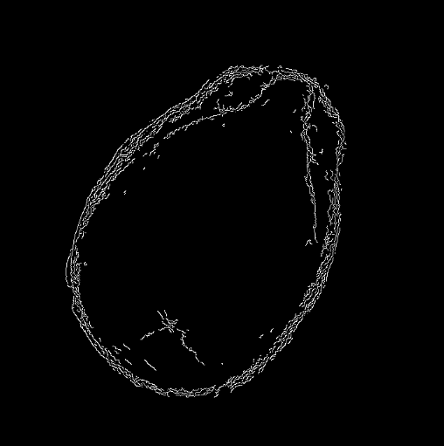
Edge segmentation
Edge detection:

Slide 5
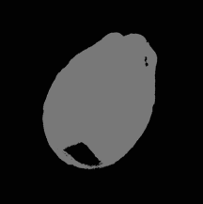
Edge segmentation
SEGMENTATION USING K-MEANS CLUSTERING (k=2):

Slide 6
Thresholding General Thresholding
General thresholding refers to the process of selecting a single threshold value to segment an image into two classes of pixels, one for the background and the other for the foreground or object of interest

Slide 7

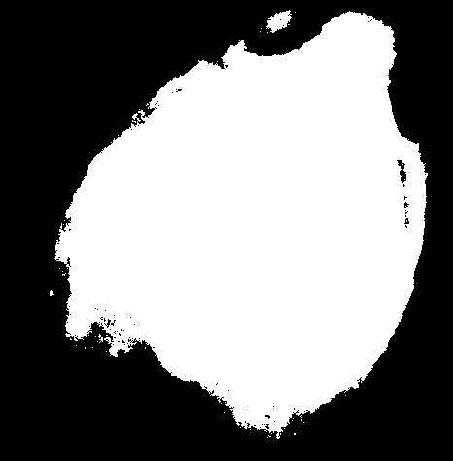
Thresholding General Thresholding
Tresh value =50
Tresh value =100

Slide 8
Thresholding Adaptative Thresholding
adaptive thresholding calculates a threshold value for each pixel in the image based on the local characteristics of the image. The image is divided into smaller regions or windows, and a threshold value is computed for each window based on the statistical properties of the pixels within that window
In our case the threshold value for each region was computed in two different ways :
The thresh value is a gaussian-weighted sum of the neighbourhood values minus the constant C (ADAPTIVE_THRESH_GAUSSIAN)
The threshold value is the mean of the neighbourhood area minus the constant C. (ADAPTIVE_THRESH_MEAN)

Slide 9
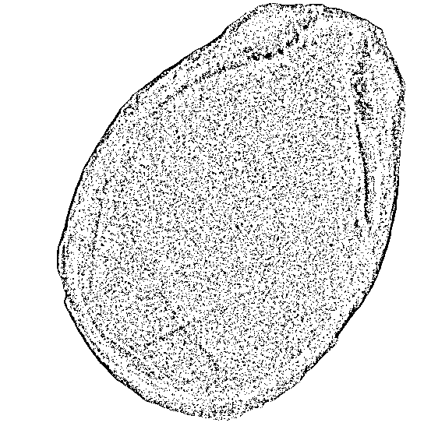
ADAPTIVE_THRESH_GAUSSIAN:
block_size = 11
constant = 2

Slide 10
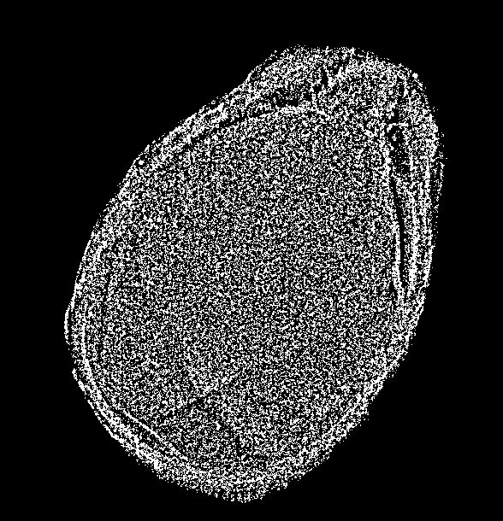
ADAPTIVE_THRESH_GAUSSIAN:
block_size = 11
constant = 0

Slide 11
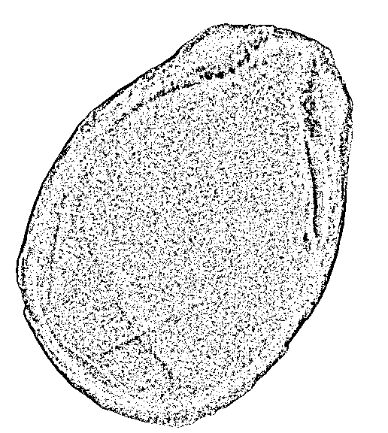
ADAPTIVE_THRESH_GAUSSIAN:
block_size = 13
constant = 2

Slide 12
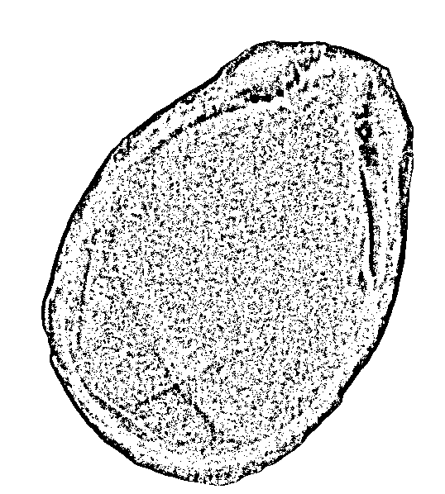
ADAPTIVE_THRESH_MEAN:
block_size = 11
constant = 2

Slide 13
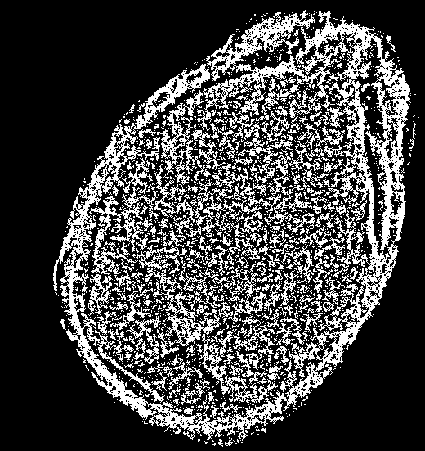
ADAPTIVE_THRESH_MEAN:
block_size = 11
constant = 0

Slide 14
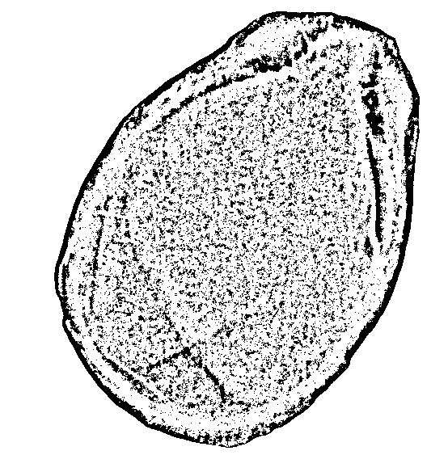
ADAPTIVE_THRESH_MEAN:
block_size = 13
constant = 2

Slide 15
Thresholding Otsu Thresholding
The Otsu method works by finding the threshold that minimizes the intra-class variance, which is the variance of the pixel intensity values within each class (foreground and background) weighted by their relative probabilities.

Slide 16
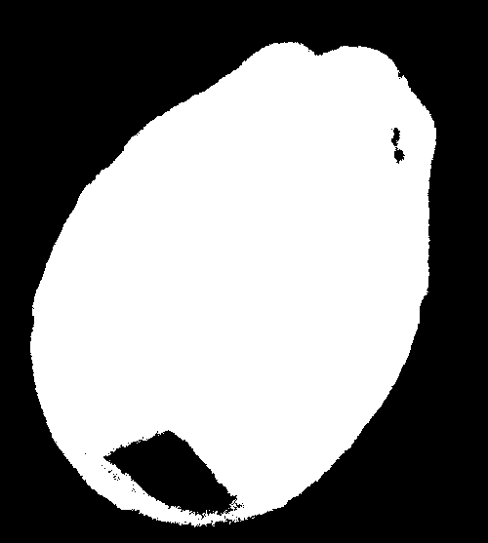
Thresholding Otsu Thresholding

Slide 17
Segmentation by region region growing
The basic idea behind region growing is to start with a seed pixel or a set of seed pixels and grow the region by iteratively adding neighboring pixels that have similar intensity values.
Steps:
Choose one or more seed pixels as the starting point for the region growing process
Define a similarity criterion that measures the similarity between the intensity values of neighboring pixels and the seed pixels. This criterion could be based on a threshold value, a statistical measure such as mean or standard deviation,,
Iterate through the neighboring pixels of the seed pixels and compare their intensity values to the similarity criterion. If a neighboring pixel satisfies the criterion, add it to the region and mark it as processed
Repeat step 3 for all newly added pixels until the region cannot be further expanded
Once the region is complete, repeat the process with new seed pixels until all desired regions have been identified.

Slide 18
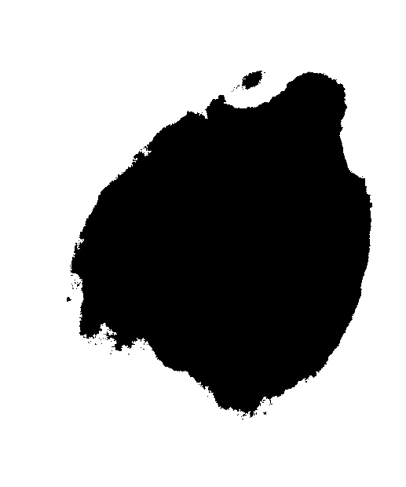
Segmentation by region region growing
(criteria)Thresh value =100
seed_point = (600, 600)

Slide 19

Segmentation by region region growing
(criteria)Thresh value =300
seed_point = (600, 600)

Slide 20
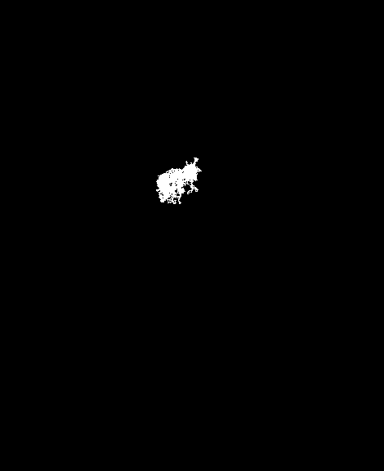
Segmentation by region region growing
(criteria)Thresh value =100
seed_point = (300, 300)

Slide 21
Watershed algorithm
The basic idea of the watershed algorithm is to treat an image as a topographic map, where high pixel values represent peaks and low pixel values represent valleys. The algorithm works by flooding the image from the valleys, with each valley representing a separate object. The water from each valley flows towards its nearest peak until it reaches a ridge line, which represents a boundary between two objects. The ridge line is used to segment the image into separate regions.
steps:
Preprocessing : remove blur – convert to gray scale image - applying thresholding
Marker selection: compute the exact Euclidean distance from every binary pixel to the nearest zero pixel, then find peaks in this distance map,
Apply the watershed algorithm :Once the markers are selected, the watershed transformation is applied to the image. This involves flooding the image with water from each marker and assigning each pixel to the nearest marker. As the water rises, it can merge with other water from neighboring markers, but it can't cross ridges that separate different objects.
Postprocessing : optional

Slide 22
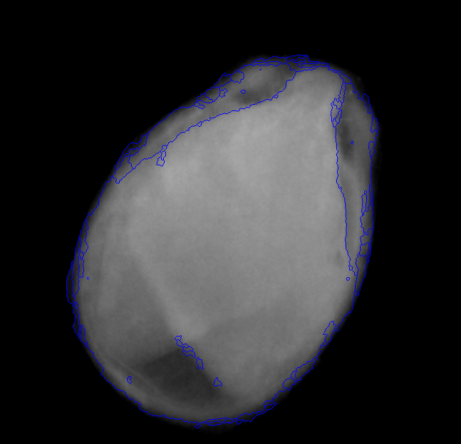
Watershed algorithm
First code example output:

Slide 23
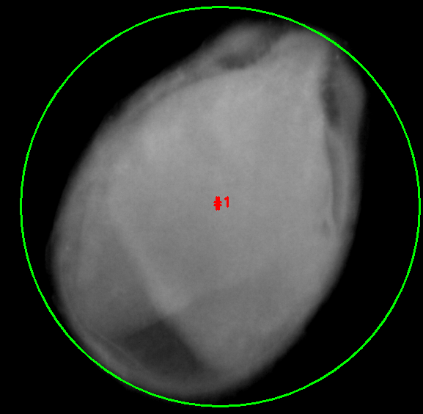
Watershed algorithm
Second code example output:
For the same image sample

Slide 24
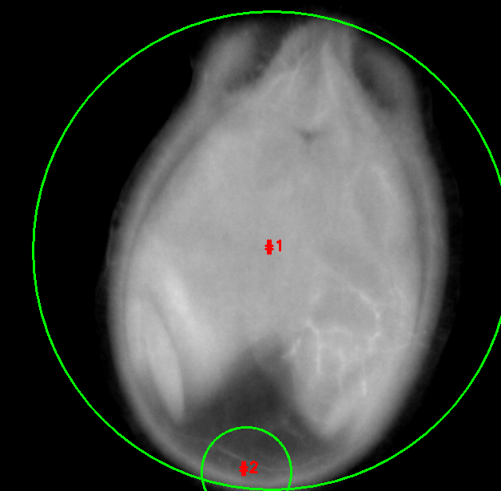
Watershed algorithm
Second code example output:
For the other image samples

Slide 25
Fuzzy C mean algorithm
a soft clustering algorithm, meaning that it allows an item to belong to multiple clusters with varying degrees of membership.
Initialization: Define the number of clusters and the initial membership values for each pixel to each cluster.
Computing cluster centers: Compute the center of each cluster based on the current membership values of all pixels.
Updating membership values: Update the membership values for each pixel based on its distance to each cluster center.
Check convergence: Check whether the algorithm has converged, i.e., the membership values for each pixel have stopped changing.
Repeat steps 2-4 until convergence: If convergence has not been achieved, repeat steps 2-4 until the membership values for all pixels stabilize.
Assign each pixel to its most probable cluster: After convergence, assign each pixel to its most probable cluster based on its membership values.

Slide 26
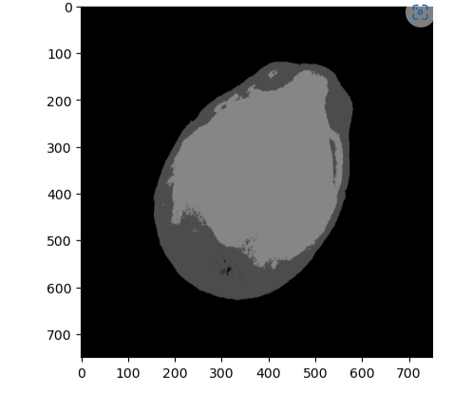
Fuzzy C mean algorithm

Slide 27
Feature extraction
Principle Components Analysis (PCA)
Independent Component Analysis (ICA)
Linear Discriminant Analysis (LDA)
Haar wavelets
SIFT (Scale-Invariant Feature Transform)
SURF (Speeded Up Robust Features)

Slide 28
Feature extraction
Principle Components Analysis (PCA):
When using PCA, we take as input our original data and try to find a combination of the input features which can best summarize the original data distribution so that to reduce its original dimensions. PCA is able to do this by maximizing variances and minimizing the reconstruction error by looking at pair wised distances. In PCA, our original data is projected into a set of orthogonal axes and each of the axes gets ranked in order of importance.

Slide 29
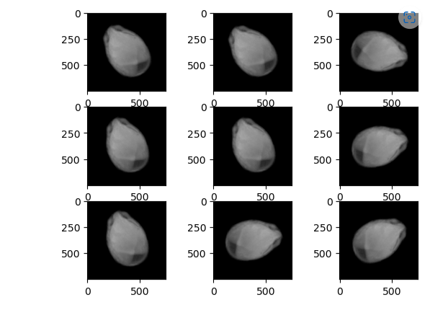
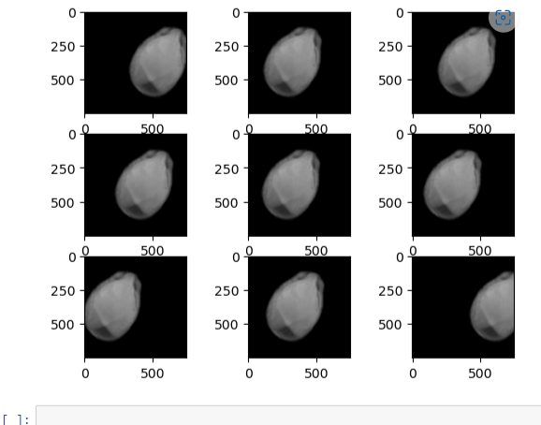
Data augmentation
We experimented with few data augmentation techniques as mentionned down below
Rotation
Horizontal shift

Slide 30
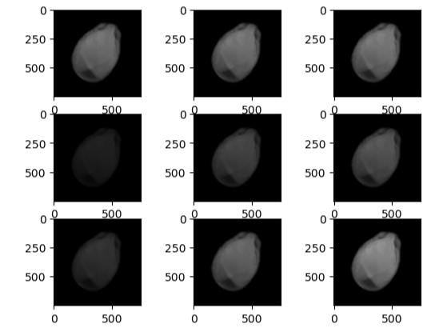
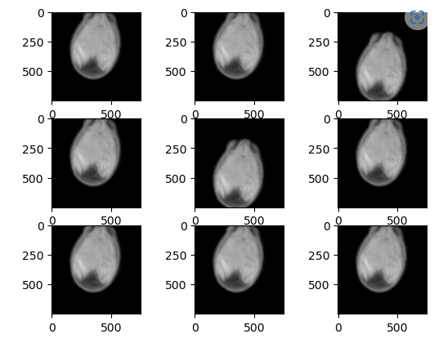
Data augmentation
Brightness
Vertical shift

Slide 31
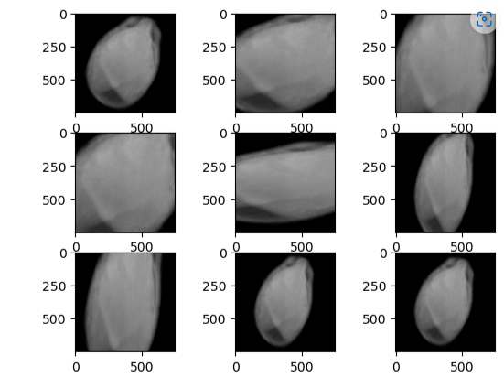
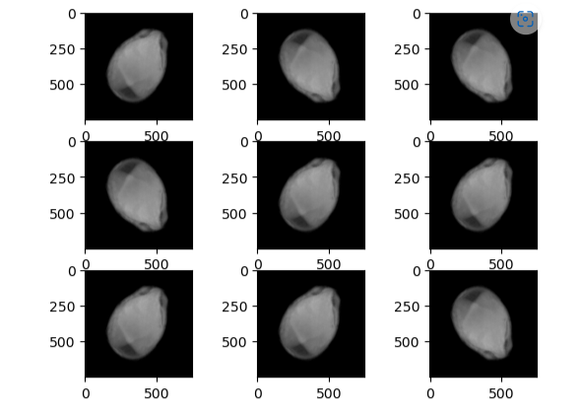
Data augmentation
Zoom
Vertical flip

Slide 32
Other relevent steps
Feature crossing :is the process of connecting multiple features from a dataset to create a new feature. This can include combining data from other sources to emphasize existing correlations.
Image scaling: useful for more efficient feature extraction with ML algorithms
Normalization: normalized_value=(raw_value-min)/(max-min)
Standardization: standarized_value=(raw_value-μ)/σ
Feature engineering: describes the process of formulating relevant features that describe the underlying data science problem as accurately as possible and make it possible for algorithms to understand and learn pattern

Slide 33
Questions:
We didn’t understand the final prep-processing used in the machine learning approach in the report
We didn’t understand
is feature extraction used in deep learning
is segmentation needed in deep learning
what are the differences between preprocessing steps in ml and in NN(dl)
is data augmentation the equivalent of oversampling in deep learning?
problematic titles: oversampling and undersampling , global selected and automated set
Data base ,,,
as for ROI, is it supposed to be extracted it using an algorithm, as part of the feature extraction process, or using our visual observations and scientific articles studying the morphology of watermelon seeds.

